Slide 1
Holt Winter Seasonality

Slide 2
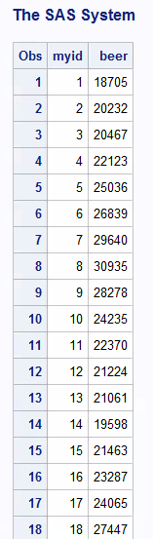
Holt Winter Exponential Smoothing
Data on Beer Shipments
52 weeks of beer total

Slide 3
Holt Winter Exponential Smoothing
There are three types of Holt Winter models
Simple Holt Winter – no trend and unchanging seasonality
Additive Holt Winter – trend plus unchanging seasonality
Multiplicative Holt Winter – trend plus changing seasonality

Slide 4
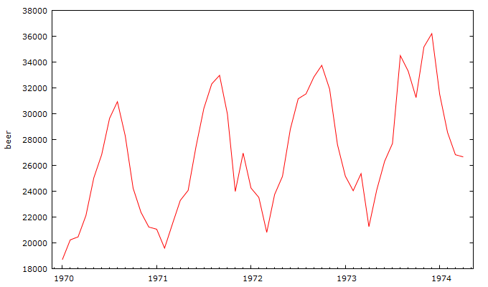
Holt Winter Exponential Smoothing
Sometimes you have seasonality in data to deal with – here is an example of beer shipments

Slide 5
Holt Winter Exponential Smoothing
What do we notice about the data in this series in terms of trend and seasonsality?

Slide 6
Holt Winter Exponential Smoothing
There looks like there is a trend here…

Slide 7
Holt Winter Exponential Smoothing
There looks like there is a trend here…
KPSS test for beer
T = 52
Lag truncation parameter = 10
Test statistic = 0.547448
10% 5% 1%
Critical values: 0.351 0.462 0.725
Interpolated p-value 0.037

Slide 8
Holt Winter Exponential Smoothing
And we can see that there is seasonality here…

Slide 9
Holt Winter Exponential Smoothing
So which Holt Winter model might we likely try?
Simple Holt Winter – no trend and unchanging seasonality
Additive Holt Winter – trend plus unchanging seasonality
Multiplicative Holt Winter – trend plus changing seasonality

Slide 10
Holt Winter Exponential Smoothing
SAS CODE
Proc forecast data=mytemp
method=addwinters
trend=2
Lead = 12
weight=(0.20 0.10 0.05)
out=myholt outfull
seasons=12;
id myid;
var beer;
run;
proc print data=myholt;
run;
Additive Holt Winters Model
Type 2 = linear trend + seaonality
Number of forecast periods = 12
w1=constant weight, w2=trend weight, w3=seasonal weight
Output data plus predictions to data set myholt
Specify 12 periods as the season period
Specify period variable
Specify time series variable
Sniff results of forecast

Slide 11
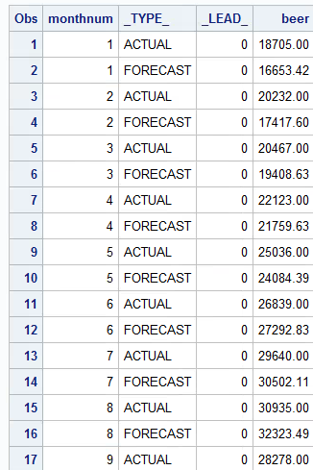
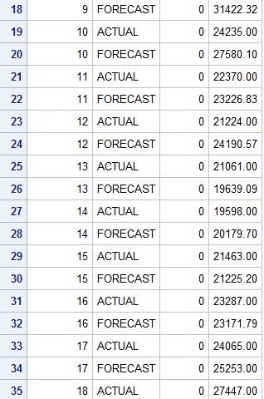
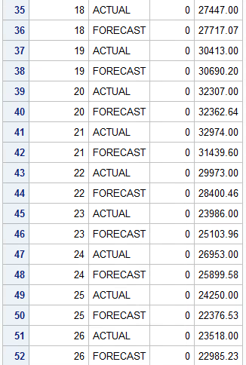
Holt Winter Exponential Smoothing
Fitted values versus actual observations

Slide 12
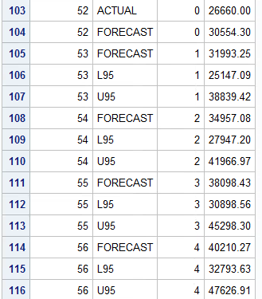
Holt Winter Exponential Smoothing
Forecasted Values into the future

Slide 13
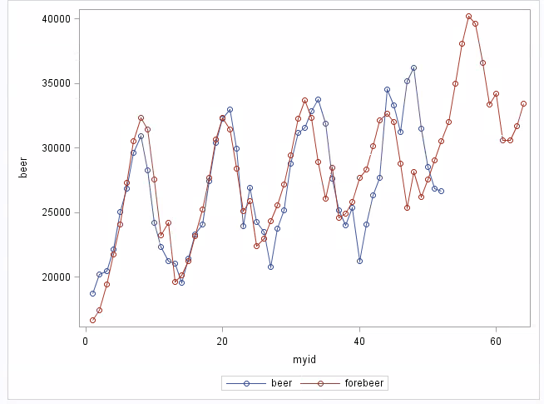
Holt Winter Exponential Smoothing
Actual and Forecast Beer Data Plot

